Slide 1
Requirements analysis of a touristic guide
IHC
Daniel Figueiredo 98498
Eduardo Fernandes 98512
João Borges 98155

Slide 2
Introduction
Virtual Guide
Motivation:
Having the ability to discover a new city
Low number of apps that covers this theme
Personal Interest:
Get to know the routes from unknown places

Slide 3
Project Objectives
Virtual Guide
High-level goals:
Show tourist routes filtered by, location, route type or by tourist guide
Have a main page with recomended routes
Allows to visit and learn a little bit more about the place
Benefits:
Flexible
Increases the user's cultural knowledge
Fast way, for a tourist, to choose a route in a place

Slide 4

Persona 1
Virtual Guide
Name: George Flynn
Gender: Male
Age: 36
Profession: Doctor
Main motives: Weariness, Curiosity about touristic points and different cultures.
Objectives: Psychologically rest, Visit places with lots of touristic points, have the maximum avail of the visit with the minimum amount of time.

Slide 5
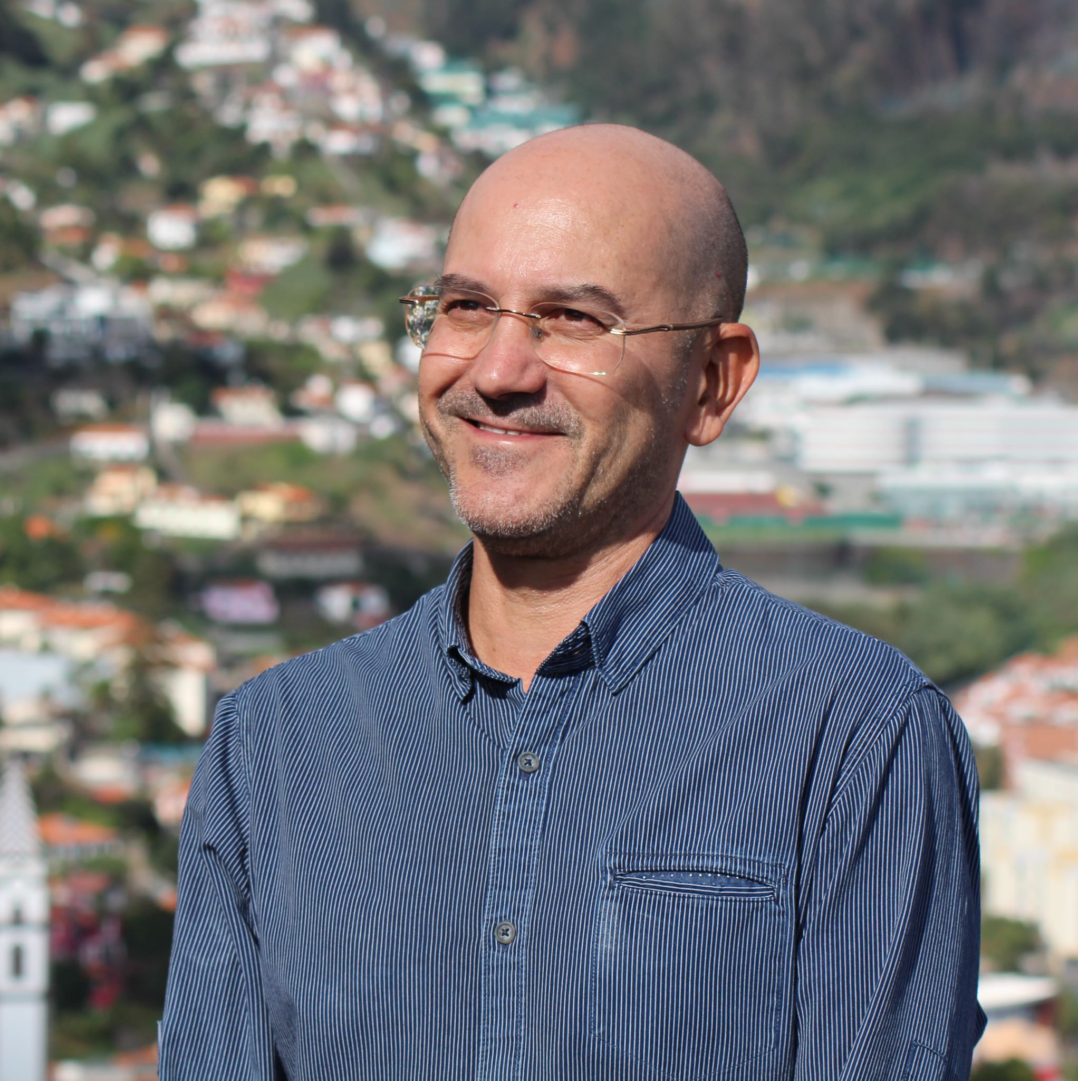
Persona 2
Virtual Guide
Name: Fernando Rias
Gender: Male
Age: 45
Profession: Librarian
Main motives: Will to help new visitors, Will to help friends with local business.
Objectives: Interchange knowledge, improve touristic experience, help local business, stimulate local economy.

Slide 6
Scenarios
Virtual Guide
George is tired of his job and decided to go on vacations to Algarve.
He doesn't know to much about this place, so he starts using the app.
Finally, he find a place called “Praia da Rocha” and decides to visit it.
Fernando checks the routes that he created to see if it was possible to do any improvement
He notices that there is a monument, the “Cristo Rei”, that is far away from the route that he designate
Finally, he proceeds to change his route so that it eases the life of the user to be able to see the monument better

Slide 7
Tasks
Virtual Guide
Doctor
0. Get a route
Plan 0: 4-5-6
If gps location services aren’t active: 1-2-4-5-6
If the visit is to a different place from where the user is: 3-4-5-6
1. Go to GPS definitions
2. Turn GPS on
3. Choose a different location
4. Get categories
5. Choose a tourist guide
6. Visit the places in the route

Slide 8
Tasks
Virtual Guide
Tourist Guide
0. Create a route
Plan 0: 1-2-3
If tourist guide wants to do changes to his own route: 4-5-6
1. Select the category
2. Select the places
3. Post the new route
4. Click the edit button
5. Switch places
6. Save the new route

Slide 9
Requirements
Virtual Guide
Non-functional requirements
Functional requirements
Data security
Intuitive and easy learning
Appealing interface
Documentation
Easy access
Can choose different categories (p.e. “Historical”, “Adventure”, etc)
Be able to evaluate the tourist route
List of tourist guides per localization and category
Recommendation menu (high rated routes)

Slide 10
Next Steps
Virtual Guide
What type of prototype are you considering? (Paper or digital prototype?)
How will you test it?

